Slide 1
MaxScale binlog Server
How-to demo

Slide 2
MariaDB Replication Cases of Use
Scale-out solutions
Analytics
Long-distance data distribution
Backups
Spreading the load
Failover alleviating
Notes:
Scale-out solutions — spreading the load among multiple replicas to improve performance. In this environment, all writes and updates must take place on the primary server. Reads, however, may take place on one or more replicas.
Analytics — live data can be created on the primary, while the analysis of the information can take place on the replica without affecting the performance of the primary.
Long-distance data distribution — if a branch office would like to work with a copy of our main data, we can use replication to create a local copy of the data for their use without requiring permanent access to the primary.
Backups: to use replication as a backup solution, replicate data from the primary to a replica, and then back up the replica.
Failover alleviating: We can set up a master and a slave (or several slaves), and then write a script that monitors the master to check whether it is up. Then instruct our applications and the slaves to change master in case of failure.

Slide 3


Challenge When Adding Many Replicas
Increased load on the primary
Replicas reconfiguration on primary failure
Notes:
When the number of replicas grows an increasing load is placed on the primary, to serve the binlogs to each slave.
When the primary server fails, some action must be performed on every replica server before a new server can become the primary server.

Slide 4

MaxScale binlog Server
MaxScale binlog server
Request binlog
Request binlog
Primary
Replicas
Notes:
ee

Slide 5
Demo

Slide 6
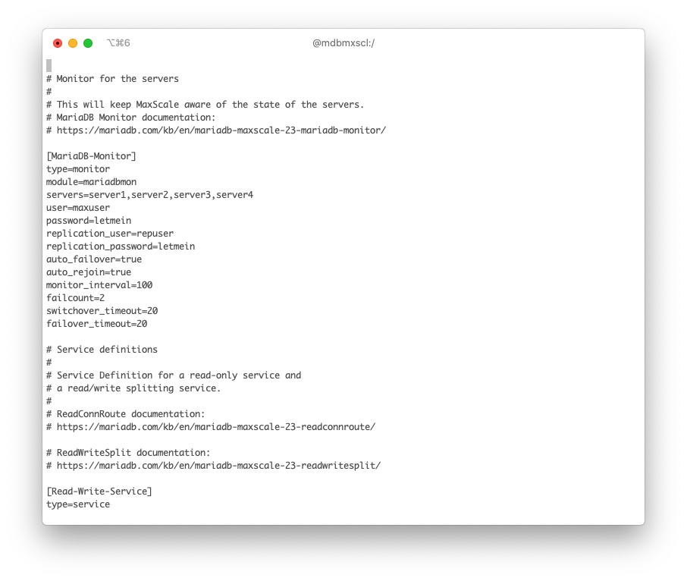
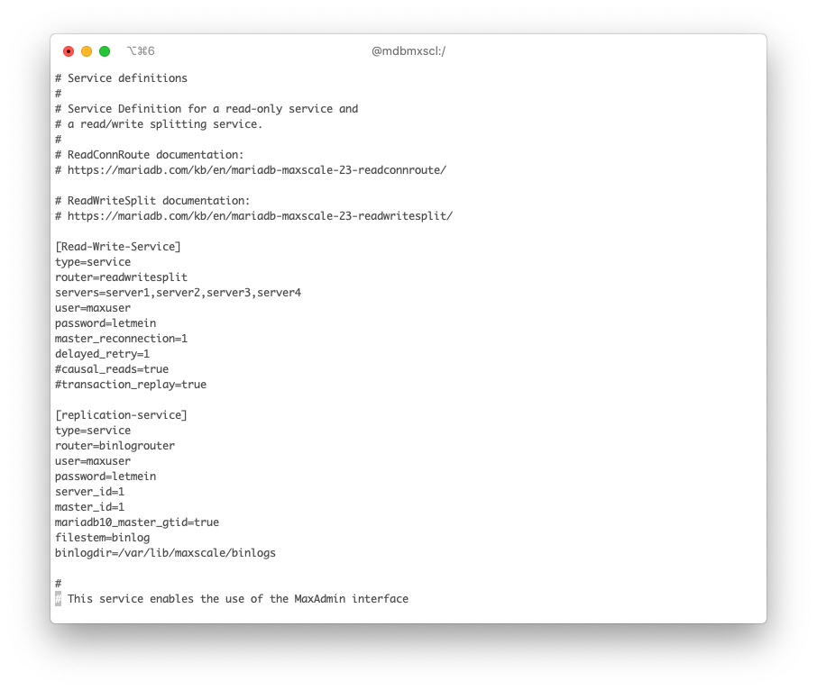
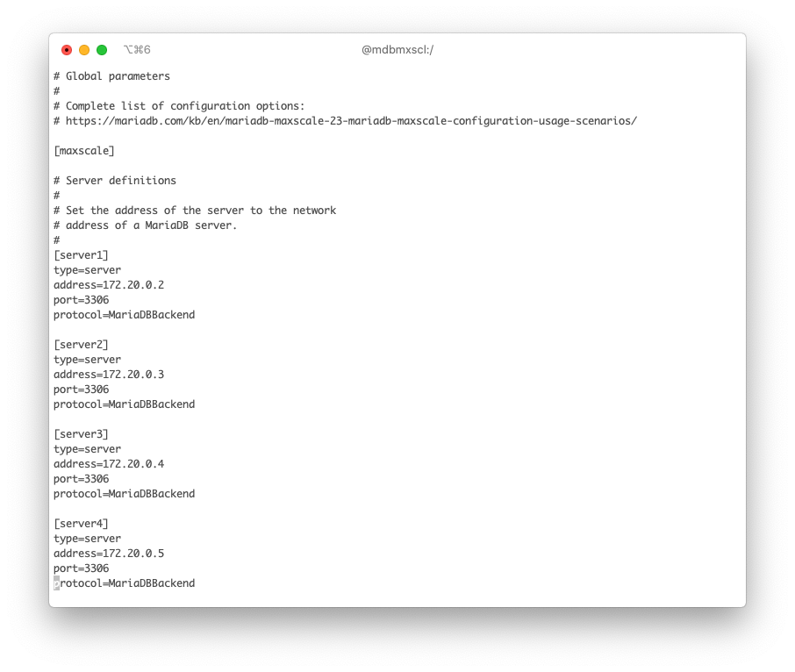
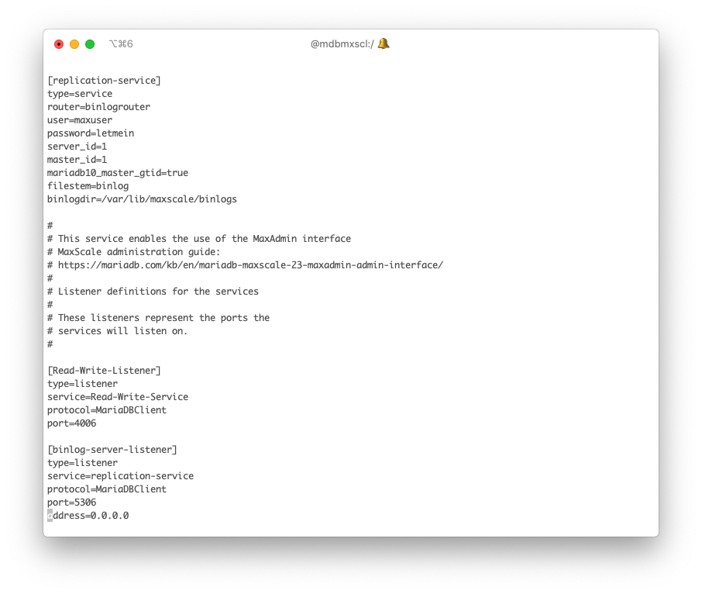

Slide 7
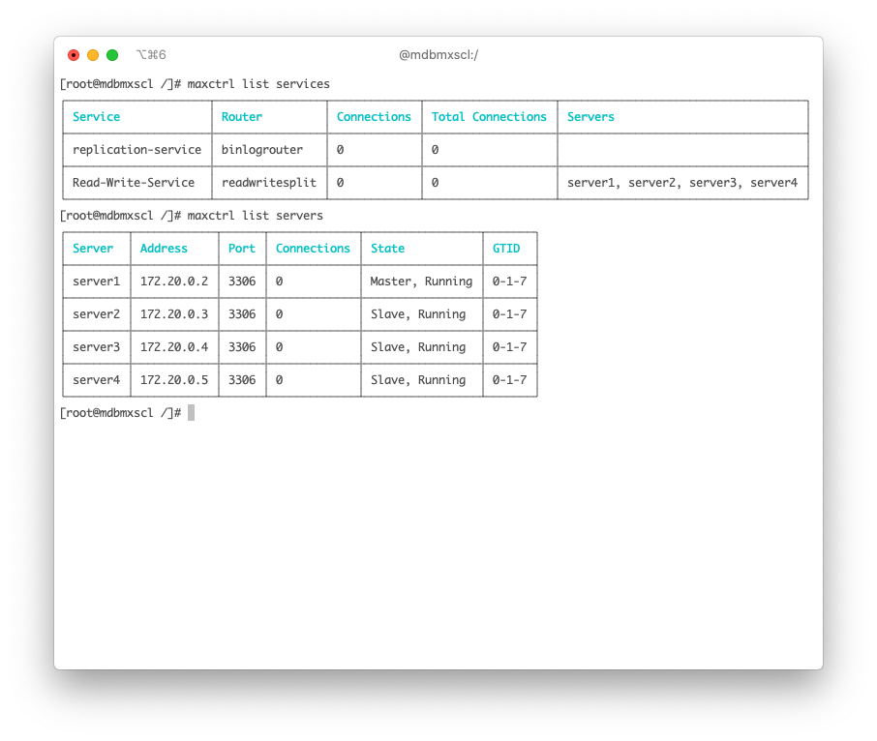
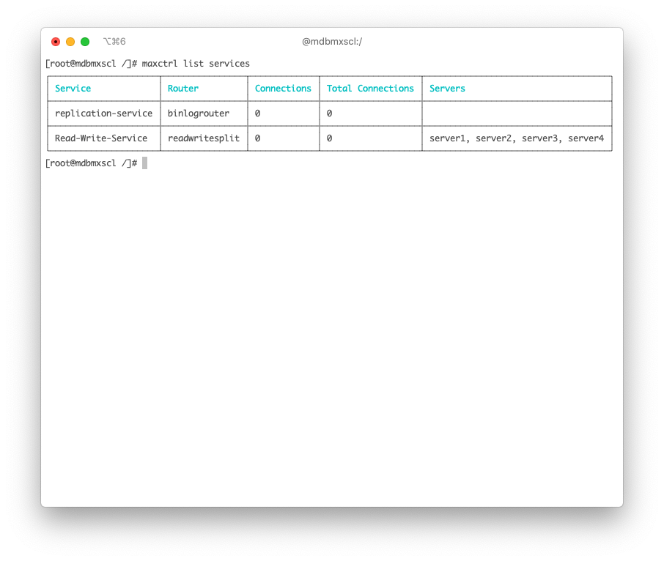

Slide 8
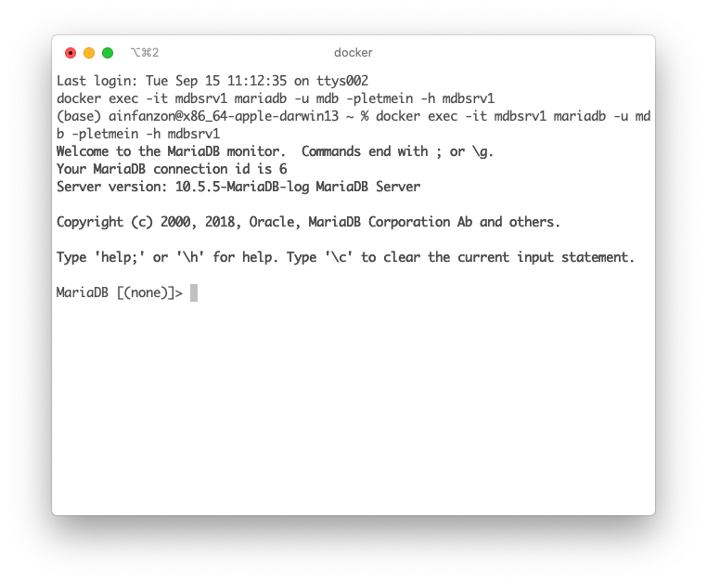




Slide 9
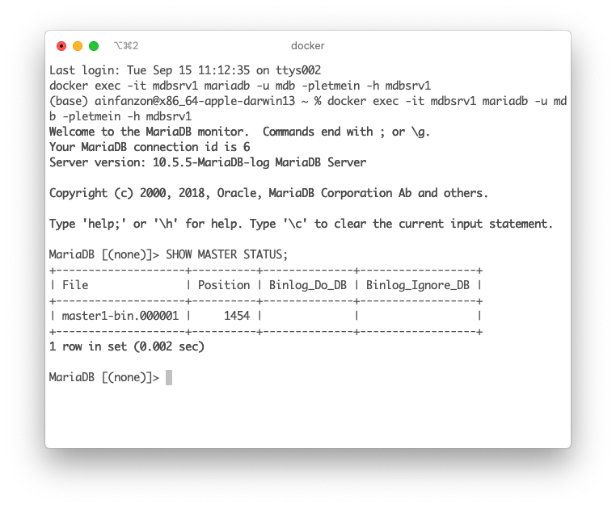
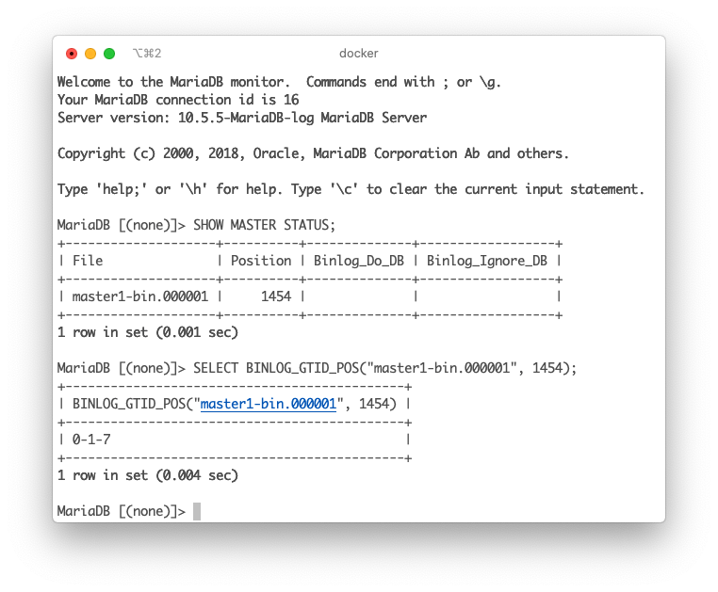

Slide 10
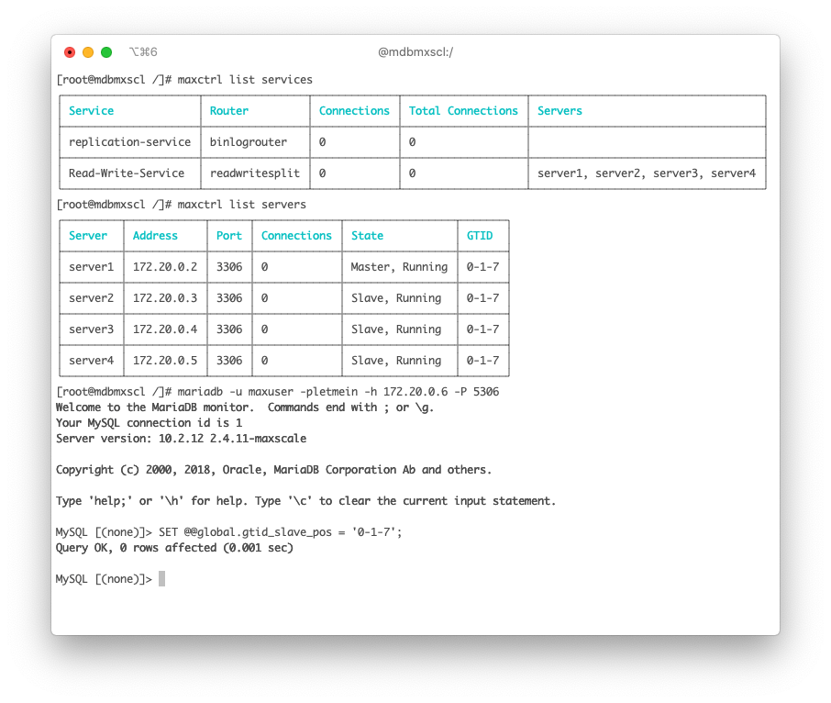
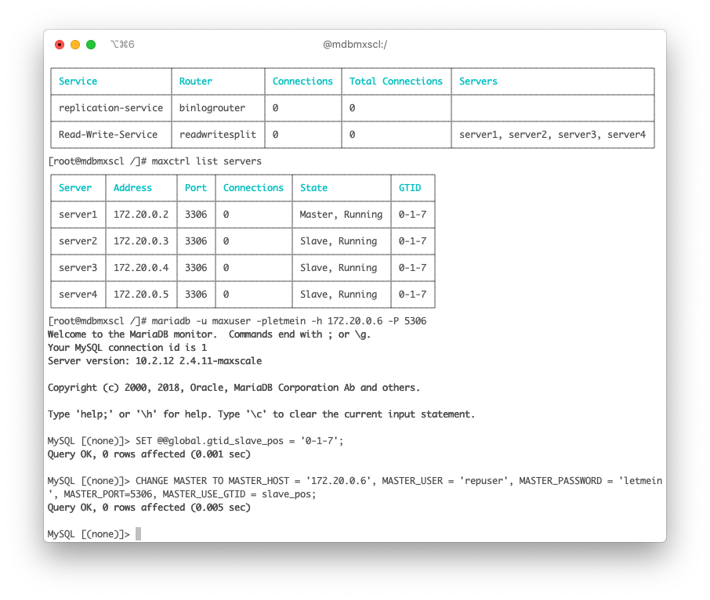
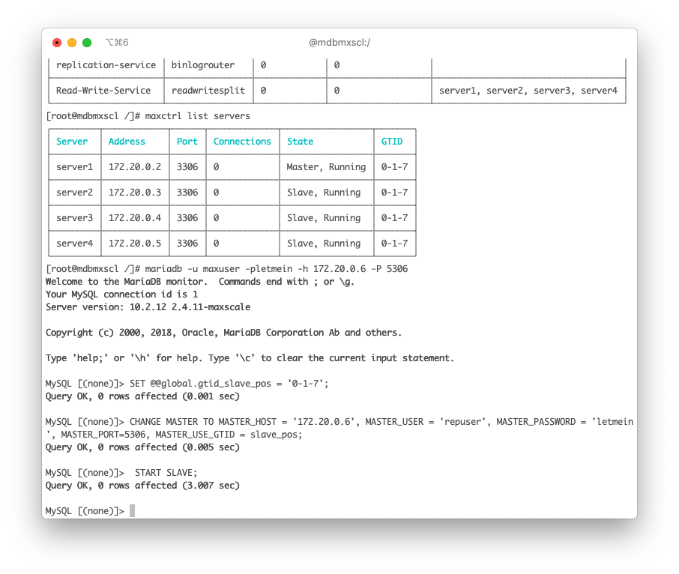

Slide 11
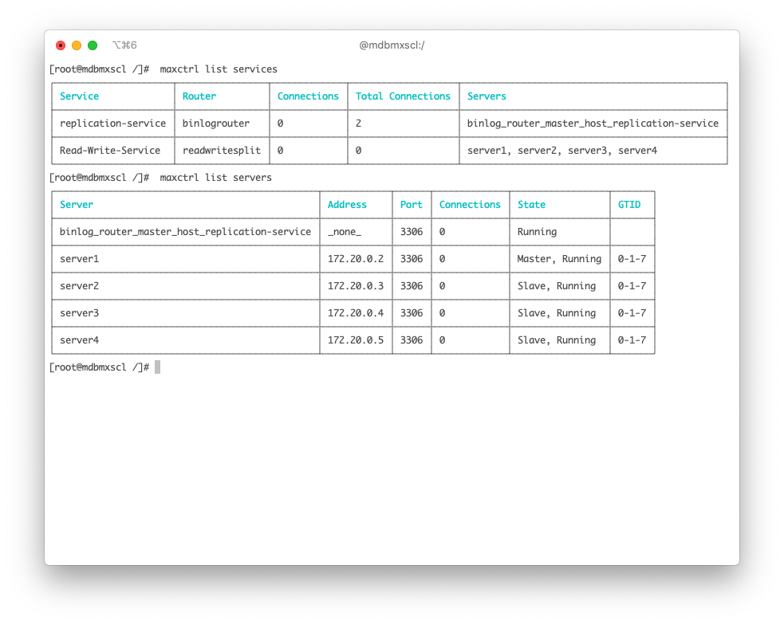

Slide 12
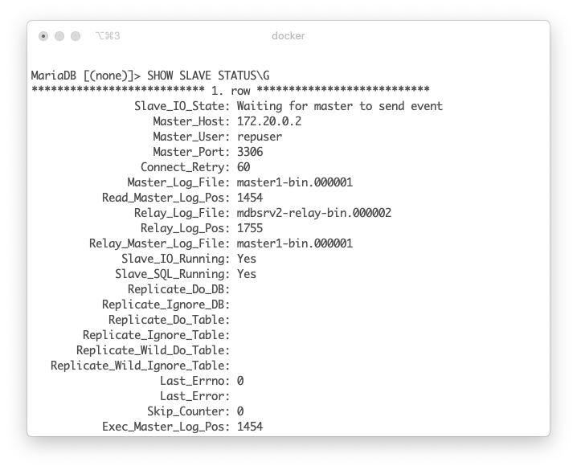
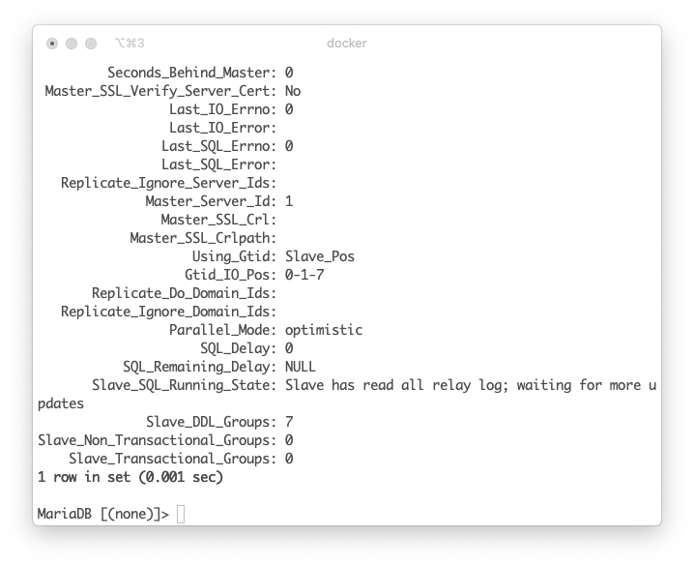

Slide 13
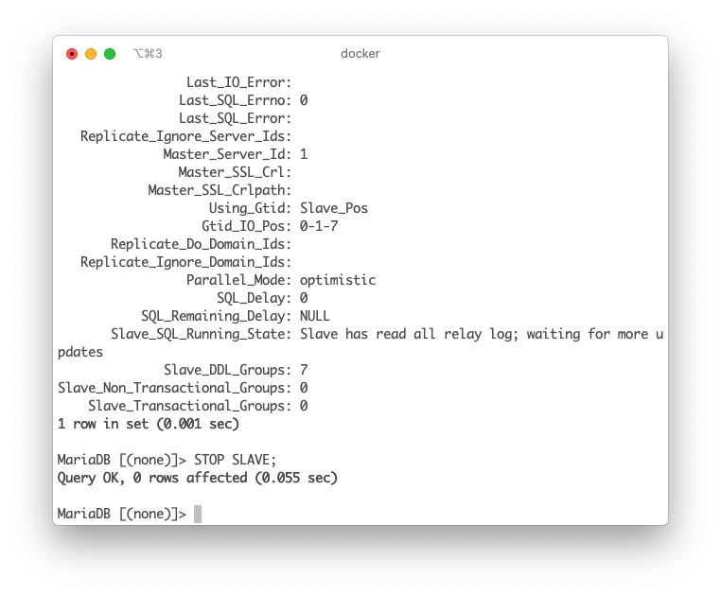
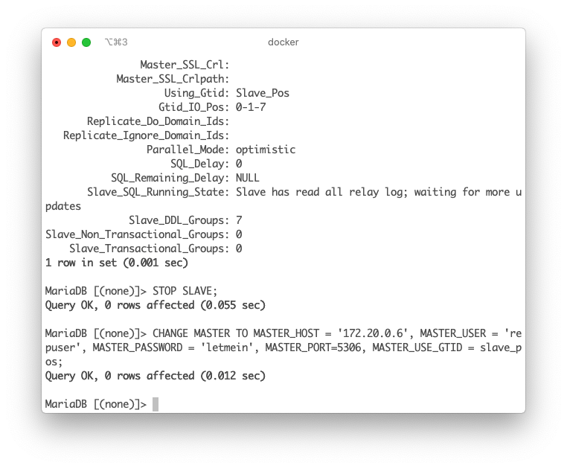
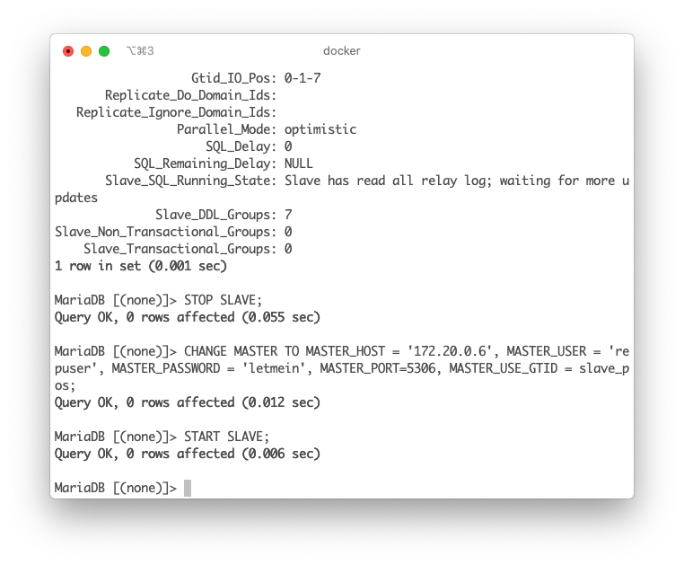

Slide 14
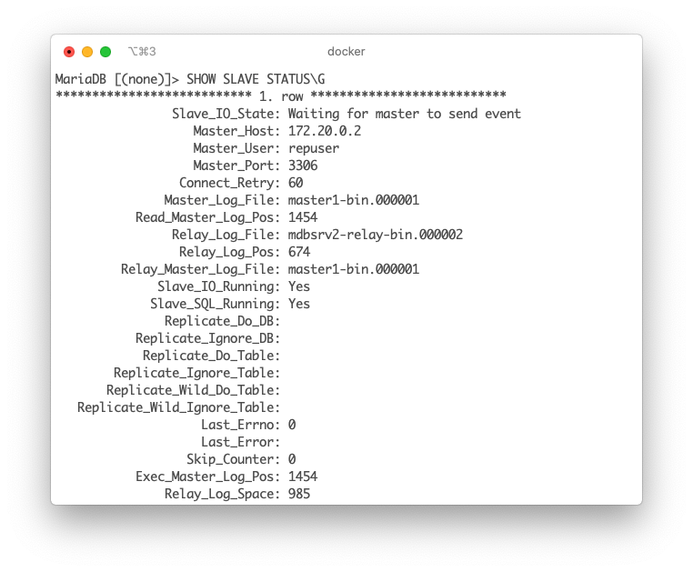
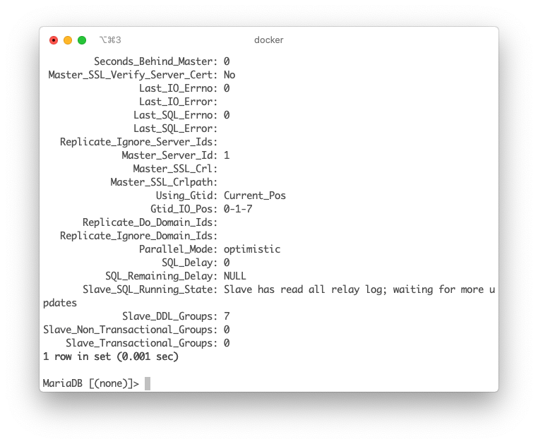

Slide 15
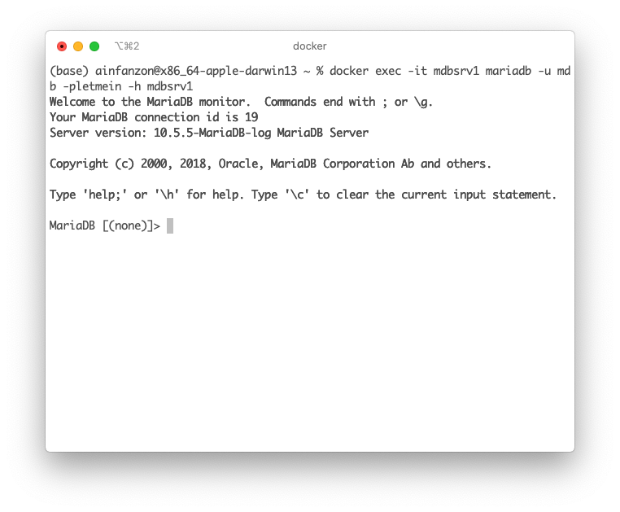



Slide 16
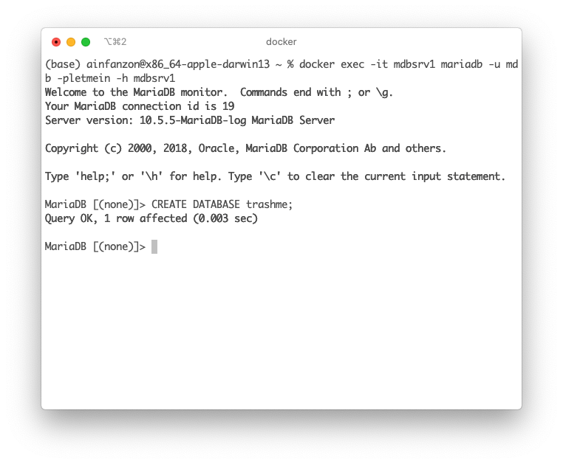

Slide 17
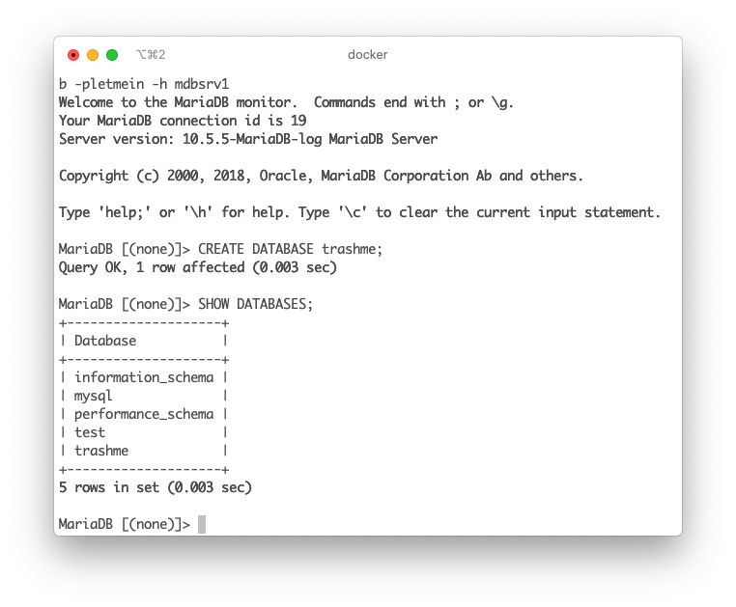
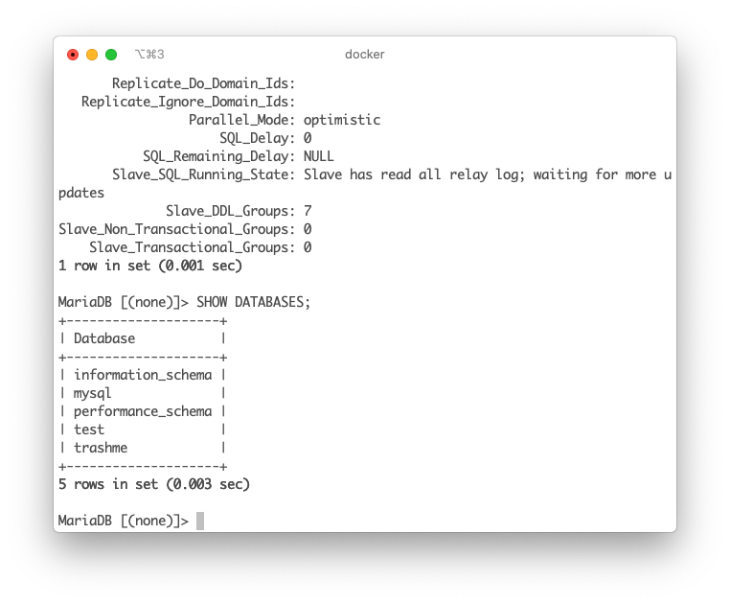



Slide 18
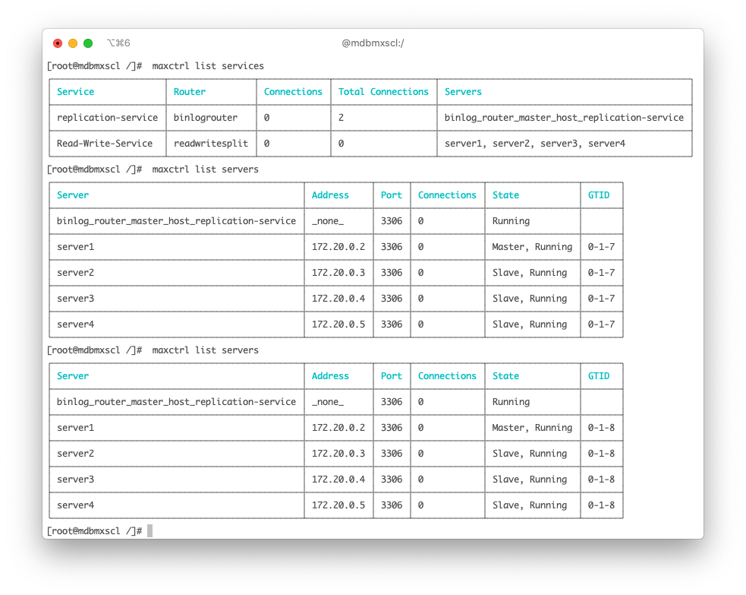

Slide 19
